Slide 1
Relationship between Unemployment and Inflation

Slide 2
The Phillips curve
If inﬂation tends to be higher when the economy is booming and if unemployment tends to be higher in recessions, does this mean that there is a ‘trade-off’ between inﬂation and unemployment?:

Slide 3
The Phillips curve
  That lower unemployment tends to be associated with higher inﬂation, and lower inﬂation with higher unemployment
  Such a trade-off was observed by the New Zealand economist, Bill Phillips and was illustrated by the famous Phillips curve.

Slide 4
The Phillips curve
Phillips curve: A curve showing the relationship between (price) inflation and unemployment
It has been used to illustrate the effects of increases in aggregate demand.
When aggregate demand rises (relative to potential output), inﬂation rises and unemployment falls: there is an upward movement along the curve
Notes:
6

Slide 5
The Phillips curve
If wages rise, the unemployed might believe that the higher wages they were offered represent a real wage increase (money illusion).
Then they accept jobs and unemployment will fall.
Notes:
6

Slide 6
The Phillips curve
The Phillips curve was bowed in to the origin.
  The usual explanation for this is that, as aggregate demand expanded, at ﬁrst, there would be plenty of surplus labour, which could meet the extra demand without the need to raise wages very much.
  But as labour became increasingly scarce, ﬁrms would ﬁnd they had to offer increasingly higher wages to obtain the labour they required, and the position of trade unions would be increasingly strengthened.

Slide 7


The original Phillips curve
Wage inflation (%)
Unemployment (%)

Slide 8
The Phillips curve
The position of the Phillips curve depended on non-demand factors causing inﬂation and unemployment:
  frictional and structural unemployment; and cost-push, structural and expectations-generated inﬂation.
  If any of these non-demand factors changed so as to raise inﬂation or unemployment, the curve would shift outwards to the right.

Slide 9
The Phillips curve
The 'Phillips curve' in recent times
  Philips curve seem to provide government with simple policy choice:
  They could trade off inﬂation against unemployment.
  the breakdown of the Phillips curve and the problem of stagflation in the 1970s
  Stagflation: high rates of inflation along with growing high unemployment
Notes:
6

Slide 10
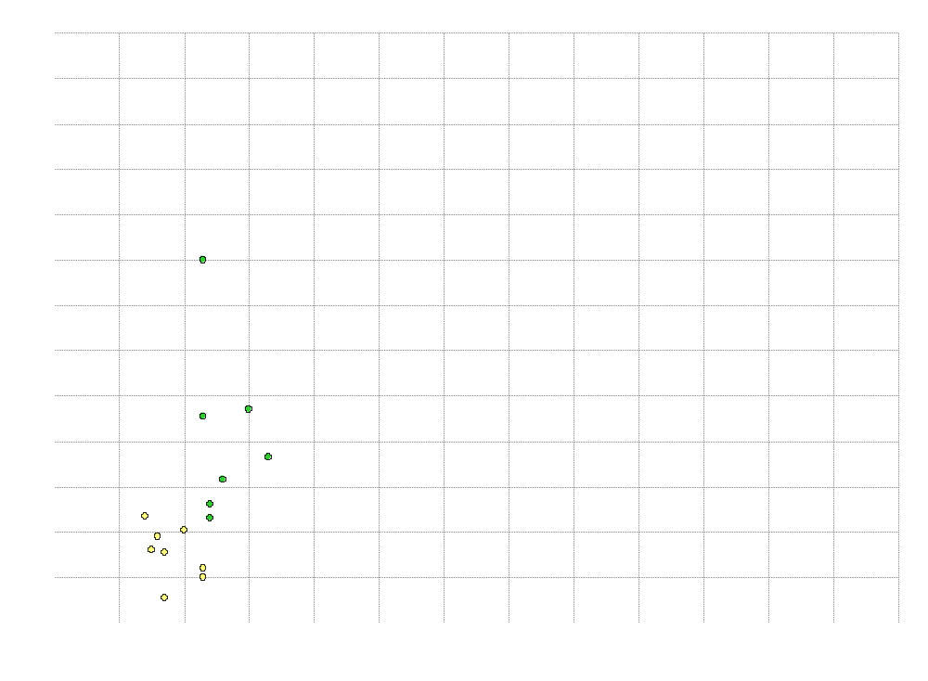

Inflation (%)
The breakdown of the Phillips curve?
74
73
71
72
70
65
69
66
62
68
61
64
67
63
60
Unemployment (%)

Slide 11
The Phillips curve
The 'Phillips curve' in recent times
  the breakdown of the Phillips curve and the problem of stagflation in the 1970s
  experience of the 1980s
Notes:
6

Slide 12
The Phillips curve
The 'Phillips curve' in recent times
  the breakdown of the Phillips curve and the problem of stagflation in the 1970s
  experience of the 1980s
  experience of recent years
Notes:
6

Slide 13
The Phillips curve
The 'Phillips curve' in recent times
  the breakdown of the Phillips curve and the problem of stagflation in the 1970s
  experience of the 1980s
  experience of recent years
  a horizontal Phillips curve?
Notes:
6

Slide 14
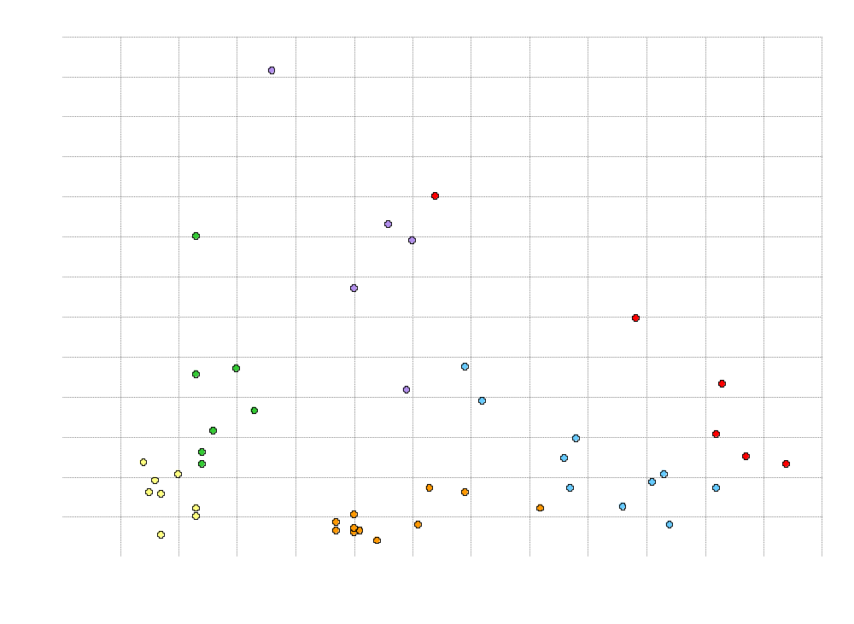

Inflation (%)
The breakdown of the Phillips curve?
75
80
76
74
77
79
81
71
90
73
78
89
82
72
70
91
85
65
69
88
84
62
68
98
87
83
66
97
95
92
86
61
64
67
06
96
94
63
05
03
99
93
60
04
02
00
01
Unemployment (%)

Slide 15
The Open Economy
The Balance of Payments

Slide 16
THE BALANCE OF PAYMENTS
All countries trade with and have financial dealings with the rest of the world
In other words, all countries are open economies
Meaning of the balance of payments:
  A record of the country’s transactions with the rest of the world.
  It shows the country’s payments to or deposits in other countries (debits) and its receipts or deposits from other countries (credits)
Notes:
2

Slide 17
THE BALANCE OF PAYMENTS
Components of Balance of Payments accounts
The current account: The record of a country’s imports and exports of goods and services, plus incomes and transfers of money to and from abroad.
Notes:
2

Slide 18
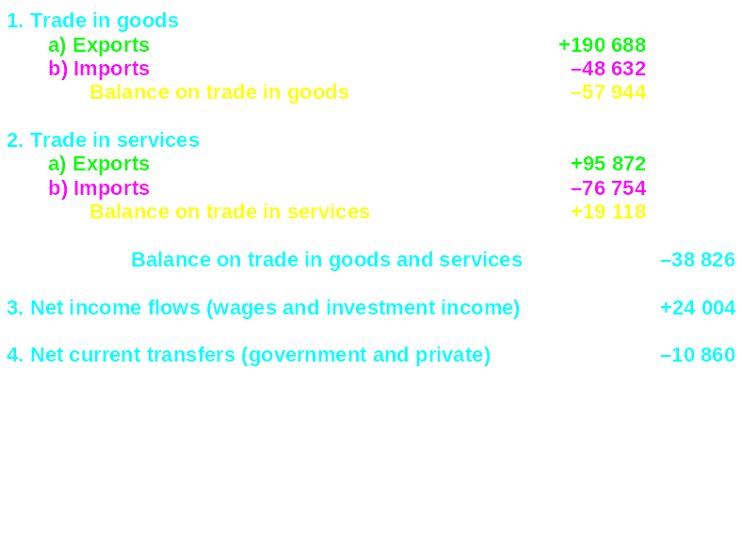
UK balance of payments: 2004 (£ millions)

Slide 19
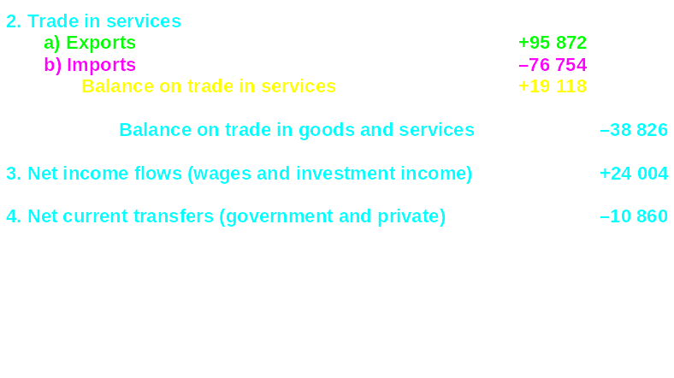
UK balance of payments: 2004 (£ millions)

Slide 20
THE BALANCE OF PAYMENTS
Meaning of the balance of payments
The current account
  trade in goods account
  trade in services account
Notes:
2

Slide 21
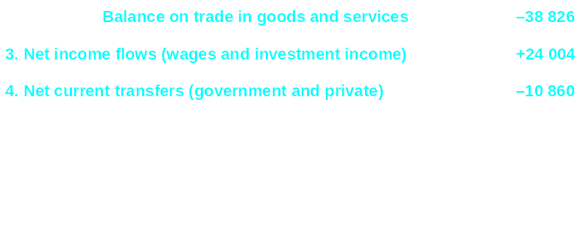
UK balance of payments: 2004 (£ millions)

Slide 22
THE BALANCE OF PAYMENTS
Meaning of the balance of payments
The current account
  trade in goods
  trade in services
    balance of trade in goods and services
Notes:
2

Slide 23
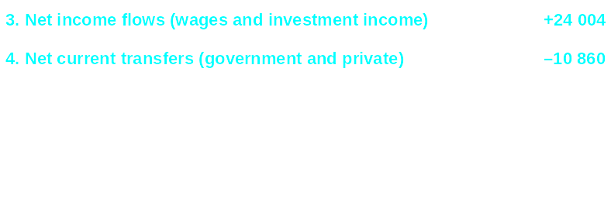
UK balance of payments: 2004 (£ millions)

Slide 24
THE BALANCE OF PAYMENTS
Meaning of the balance of payments
The current account
  trade in goods
  trade in services
    balance of trade in goods and services
  current transfers of money
  income flows
Notes:
2

Slide 25
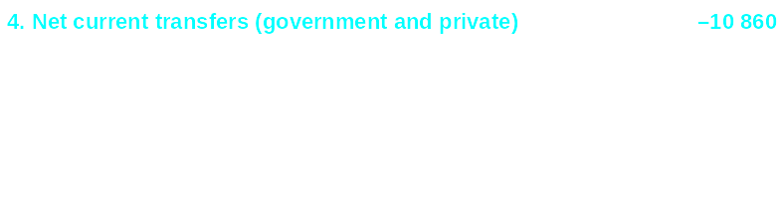
UK balance of payments: 2004 (£ millions)

Slide 26

UK balance of payments: 2004 (£ millions)

Slide 27
THE BALANCE OF PAYMENTS
Meaning of the balance of payments
The current account
  trade in goods
  trade in services
    balance of trade in goods and services
  current transfers and income flows
    balance on current account
Notes:
2

Slide 28

UK balance of payments: 2004 (£ millions)

Slide 29
THE BALANCE OF PAYMENTS
The capital account: the flow of funds into and out of a country, acquisition or disposal of fixed assets, transfer of funds by migrants, payment of grants by government for oversea projects and receipts of money for projects.
Notes:
3

Slide 30
UK balance of payments: 2004 (£ millions)

Slide 31
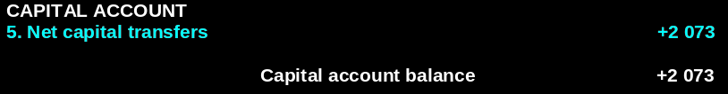
UK balance of payments: 2004 (£ millions)

Slide 32
THE BALANCE OF PAYMENTS
The financial account: records cross-border changes in the holding of shares, property, bank deposits and loans, government securities.
Unlike the current account which is concerned with money incomes, the financial account is concerned with the purchase and sale of assets
Notes:
3

Slide 33
THE BALANCE OF PAYMENTS
The capital account
The financial account
  investment
Notes:
3

Slide 34
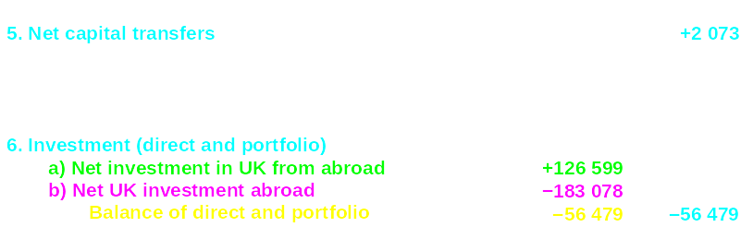
UK balance of payments: 2004 (£ millions)

Slide 35
THE BALANCE OF PAYMENTS
The capital account
The financial account
  investment
    direct
    portfolio
  other financial flows (mainly short-term)
Notes:
3

Slide 36
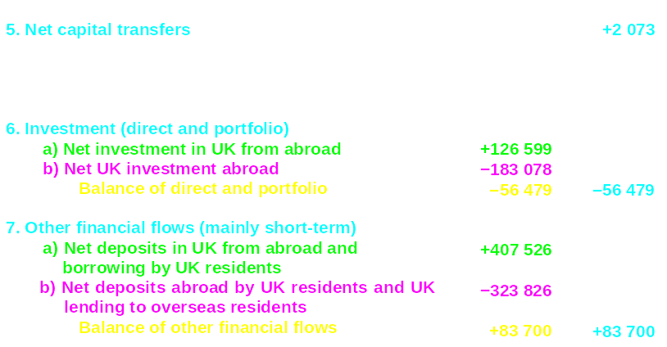
UK balance of payments: 2004 (£ millions)

Slide 37
THE BALANCE OF PAYMENTS
The capital account
The financial account
  investment
    direct
    portfolio
  other financial flows (mainly short-term)
  flows to and from reserves
Notes:
3

Slide 38
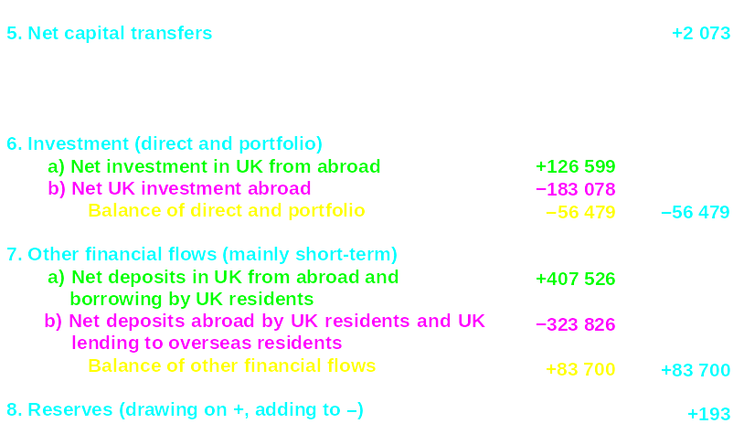
UK balance of payments: 2004 (£ millions)

Slide 39
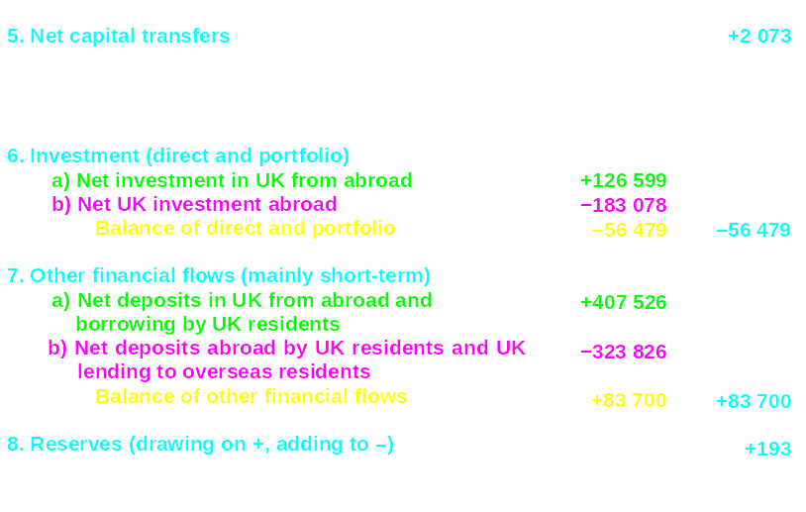
UK balance of payments: 2004 (£ millions)

Slide 40
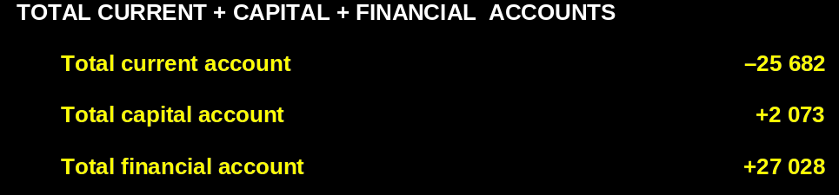
UK balance of payments: 2004 (£ millions)

Slide 41
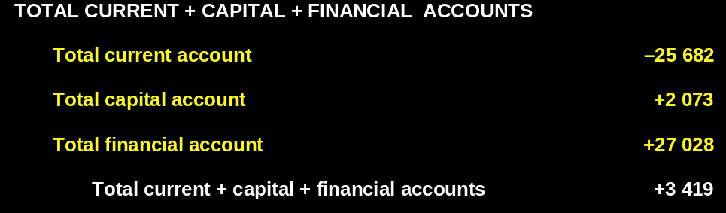
UK balance of payments: 2004 (£ millions)

Slide 42
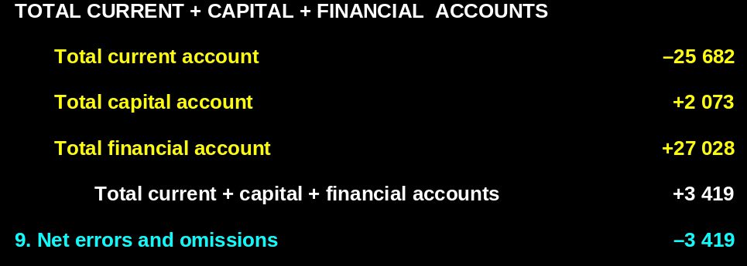
UK balance of payments: 2004 (£ millions)

Slide 43
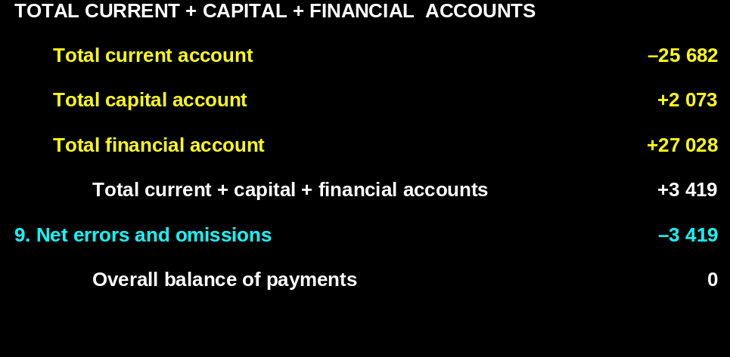
UK balance of payments: 2004 (£ millions)

Slide 44
THE BALANCE OF PAYMENTS
The capital account
The financial account
  investment
Exercise: visit the website of BoG https://www.bog.gov.gh/economic-data/balance-of-payment/ and download the BOP for Ghana
Notes:
3

Slide 45
The Open Economy
Exchange Rates

Slide 46
EXCHANGE RATES
Nominal exchange rate is the quantity of local currency (say Gh ¢) needed to exchange for one unit of a foreign currency (say $).
The rate of exchange: An exchange rate is the rate at which one currency trades for another on the foreign exchange market
Example: (Gh¢5.8 = $1)
Notes:
4

Slide 47
EXCHANGE RATES
  Individual rates of exchange
  Exchange rate index: A weighted average exchange rate expressed as an index, where the value of the index is 100 in a given base year
  Arbitrage: Buying an asset in a market where it has a lower price and selling it again in another market where it has a higher price and thereby making a profit.
Notes:
4

Slide 48
TYPES OF EXCHANGE RATES
The rate of exchange
  individual rates of exchange
  exchange rate index
Fixed Exchange rate:
A fixed exchange rate (pegged exchange rate) is a type of exchange rate regime in which a one country’s currency's value is fixed or pegged by a monetary authority against the value of another country’s currency.
Example: Gh¢2 is fixed at 1$
Notes:
4

Slide 49
TYPES OF EXCHANGE RATES
The rate of exchange
  individual rates of exchange
  exchange rate index
Managed floating exchange rate:
Exchange rates are determined by market forces but government intervene occasionally by buying and selling currencies or changing their money supplies to affect their exchange rates.
Notes:
4

Slide 50
TYPES OF EXCHANGE RATES
The rate of exchange
  individual rates of exchange
  exchange rate index
Purely flexible or floating exchange rates
  When the government does not intervene in the foreign exchange markets, but simply allows the exchange rate to be freely determined by demand and supply.
Notes:
4

Slide 51

Determination of the rate of exchange
¢/$
Q of $

Slide 52

Determination of the rate of exchange
¢/$
D by Ghana
Q of $

Slide 53

Determination of the rate of exchange
¢/$
S by US
Excess supply of dollars leads to a depreciation of $ and appreciation of ¢
b
a
D by Ghana
Q_{D}
Q_{S}
Q of $

Slide 54
Determination of the rate of exchange
¢/$
S by US
Shortage of dollars leads to an appreciation of $ and depreciation of ¢
d
c
D by Ghana
Q_{S}
Q_{D}
Q of $

Slide 55
EXCHANGE RATES
The rate of exchange
  individual rates of exchange
  exchange rate index
Floating exchange rates
  the equilibrium exchange rate
  appreciation and depreciation
Notes:
4

Slide 56
EXCHANGE RATES
  Depreciation: A fall in the free-market exchange rate of the domestic currency with foreign currencies. This is, more local currency is required to exchange for the same unit of a foreign currency
  Appreciation A rise in the free-market exchange rate of the domestic currency with foreign currencies. This is, less local currency is required to exchange for the same unit of a foreign currency
Notes:
4

Slide 57


Floating exchange rates: movement to a new equilibrium
¢/$
S₁
D₁
Q of $

Slide 58

Floating exchange rates: movement to a new equilibrium
¢/$
S₁
S₂
D₁
Q of $

Slide 59

Floating exchange rates: movement to a new equilibrium
¢/$
S₁
S₂
D₁
D₂
Q of $

Slide 60
EXCHANGE RATES
The rate of exchange
  individual rates of exchange
  exchange rate index
Floating exchange rates
  the equilibrium exchange rate
  appreciation and depreciation
  causes of shifts in currency demand and supply
Notes:
4

Slide 61


Shifts in currency demand and supply
¢/$
S₁
S₂
D₁
D₂
Q of $

Slide 62
EXCHANGE RATES
Factors the could lead to depreciation of a currency
Higher inflation in domestic economy than abroad
A rise in domestic incomes relative to incomes abroad
Fall in domestic interest rates
Relative investment prospects improving abroad
Speculation that exchange rate will fall (depreciation of the domestic currency)
Notes:
4

Slide 63
EXCHANGE RATES
The rate of exchange
  individual rates of exchange
  exchange rate index
Floating exchange rates
  the equilibrium exchange rate
  appreciation and depreciation
  causes of shifts in currency demand and supply
  exchange rates and the balance of payments
Notes:
4

Slide 64
EXCHANGE RATES
  Exchange rates and the balance of payments
  In a free foreign exchange market, the balance of payments will automatically balance. (why?)
  The credit side of the balance of payments constitutes the demand for Ghana Cedis. Example: when people abroad buy Ghana’s exports or assets, they will demand Ghana cedis in order to pay for them
Notes:
4

Slide 65
EXCHANGE RATES
  Exchange rates and the balance of payments
  The debit side constitutes the supply of Ghana cedis.
  Example: When Ghana residents buy foreign goods or assets, the importers of them will require foreign currency to pay for them. They will thus supply Ghana cedis
  A floating exchange rate ensures that the demand for Ghana Cedis always equals the supply
Notes:
4

Slide 66
EXCHANGE RATES
Managing the Exchange rate
Government intervention
  Reducing short-term fluctuations
    Intervention using reserves (buying and selling of foreign currencies)
    Borrowing from abroad
    Changes in interest rates
    Import controls: the use of tariffs and quotas
Notes:
5

Slide 67
EXCHANGE RATES
Managing the Exchange rate
Government intervention
  maintaining a fixed rate of exchange
    Deflation
    Supply-side policies: increase the long-term competitiveness of the economy
    Import controls
      The use of tariffs and quotas
Notes:
5

Slide 68
Relationships between the Four Macro Objectives

Slide 69
Relationship between the four macroeconomic objectives
Aggregate demand and the four objectives
  effects of increases in aggregate demand (relative to potential output)
  how the objectives vary with the course of the business cycle
Notes:
6

Slide 70

The business cycle and the four macroeconomic objectives
Potential output
National output
Actual
output
O
Time

Slide 71
The business cycle and the four macroeconomic objectives
High output, low unemployment
but
high inflation, current account deficit
Potential output
3
National output
4
3 (Peaking out)
2
Actual
output
4 (Recession)
2 (Expansion)
1
1 (Upturn
Or Trough)
Low inflation, current account surplus
but
How output, High unemployment
O
Time

Slide 72
Thank You
Notes:
6

